Slide 1
Benchmarking with YOLOv8
Group F
Alexander Ov, Nina Fajardo, Jeff Magbitang, Ruben Banzon

Slide 2
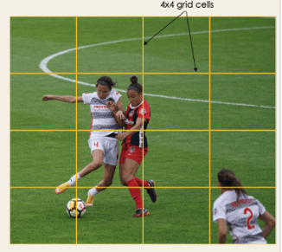
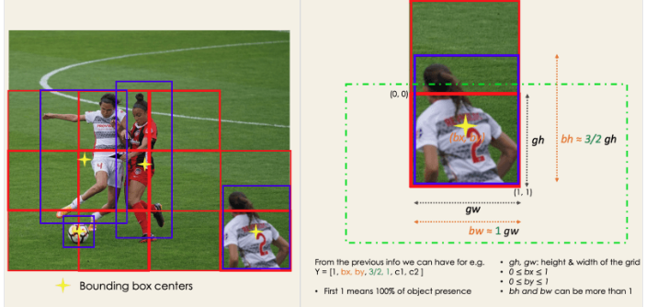
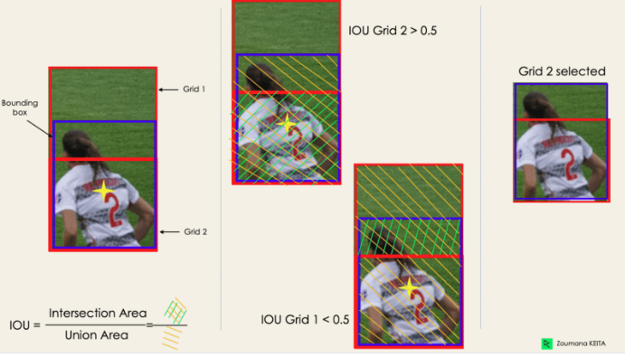
YOLO Modeling
Residual Blocks
Bounding box Regression
Intersections Over Unions
Non-Max Suppression or NMS
Keeping only highest probability score of detection

Slide 3
What changed since our proposal?

Slide 4

Changed to Yolov8 from Yolov7
Simpler to train
Previous problems with testing with Yolov7
Differences with working with AMD vs Intel
Following different tutorials
Overall: Was just not working for us

Slide 5
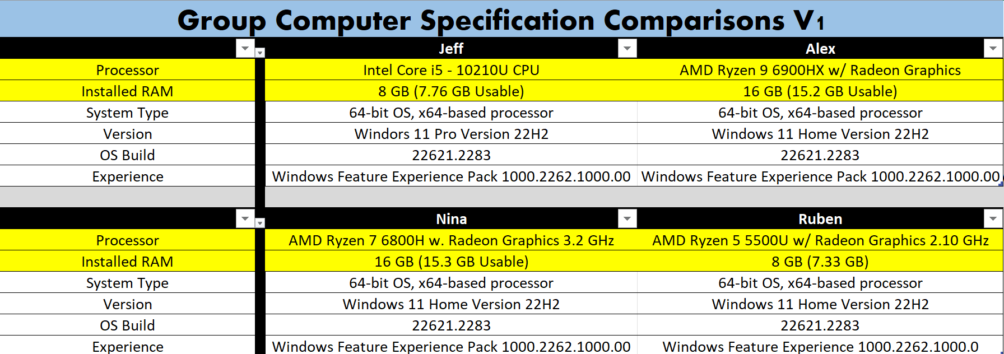
Old Computer Specifications
Ruben and Jeff switched devices due to slow speed.
Nina switched devices due to computer problems.

Slide 6
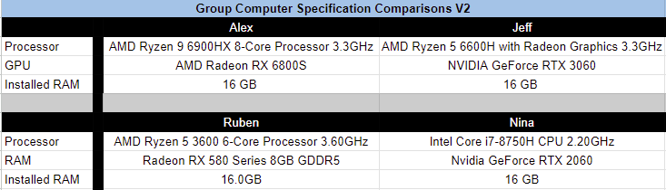
New Computer Specifications

Slide 7
Training our Datasets & Analysis

Slide 8
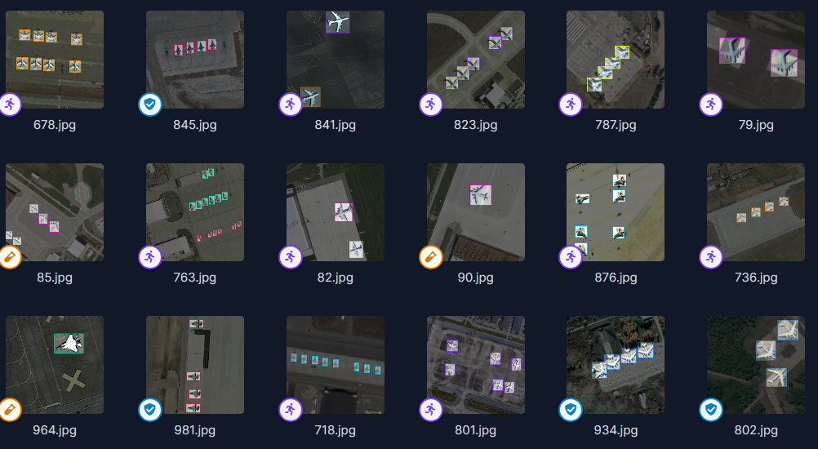
Dataset Used for Training

Slide 9
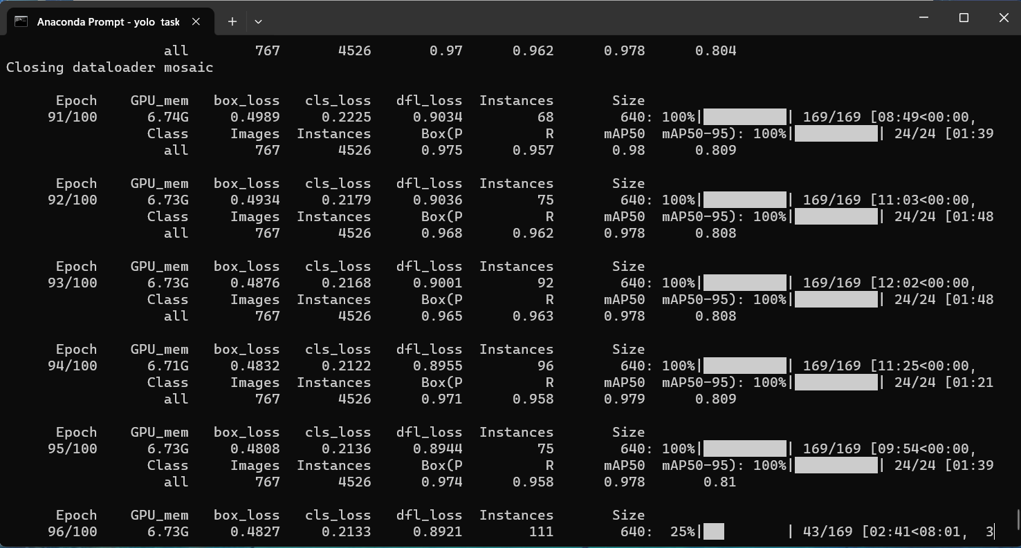
Training

Slide 10
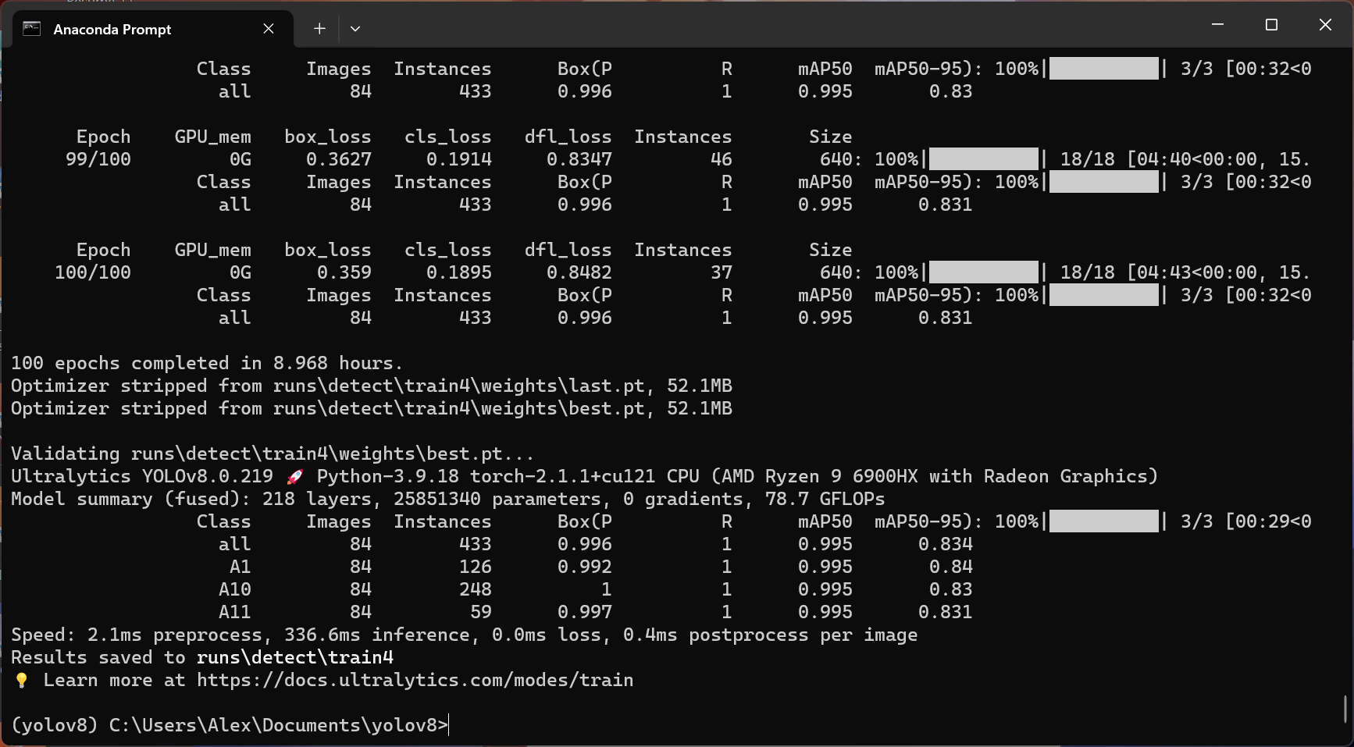
Training

Slide 11
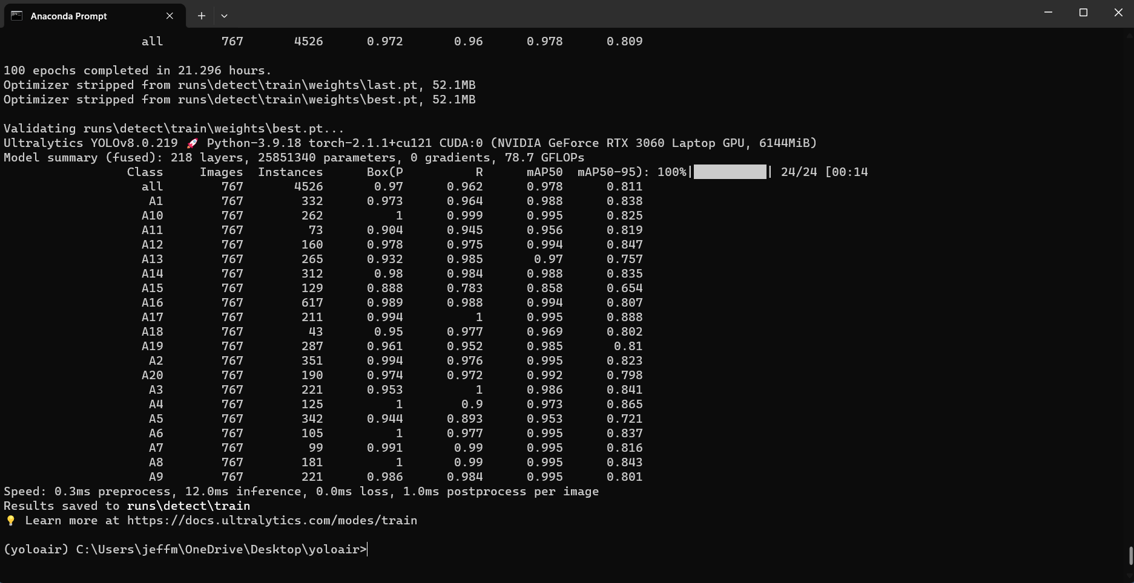
Training

Slide 12
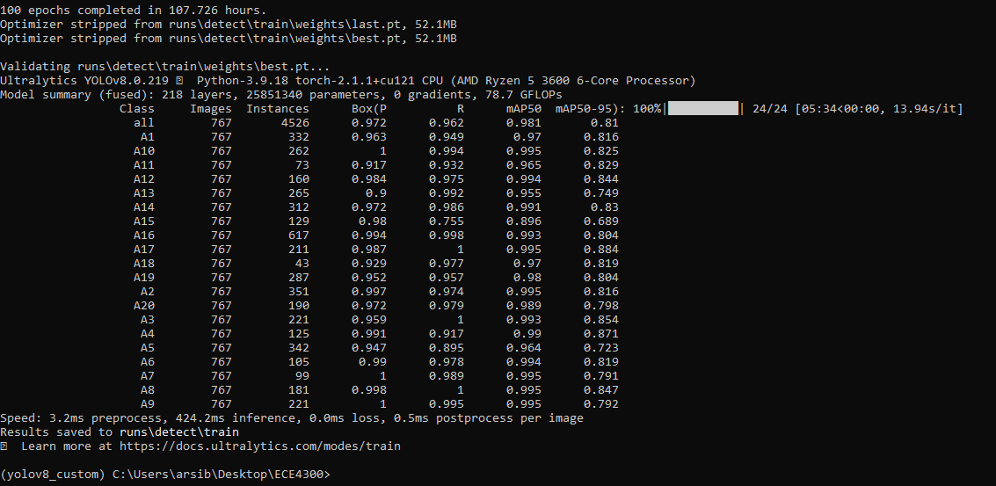
Training

Slide 13
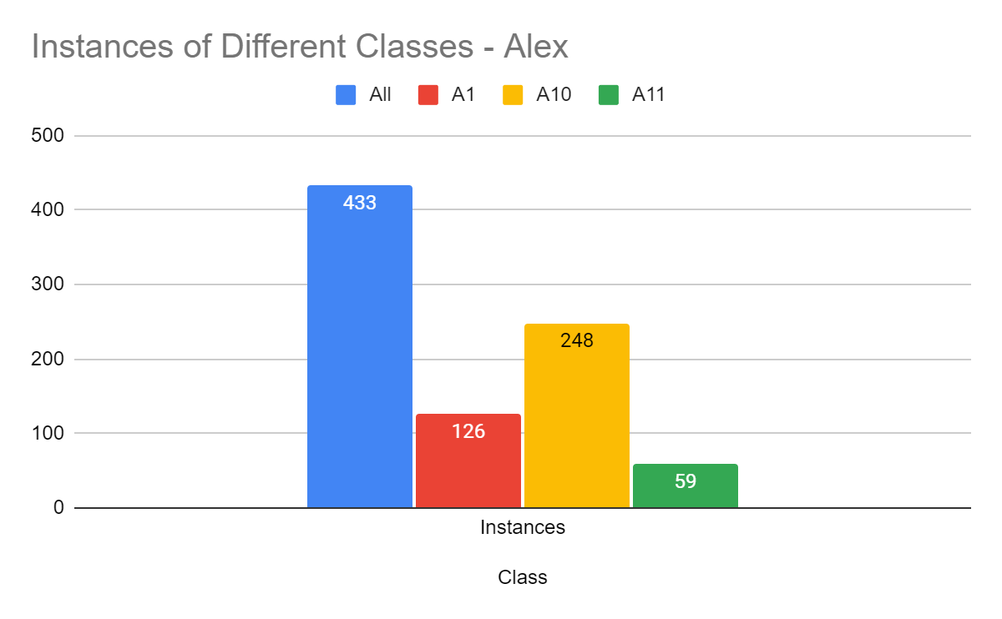
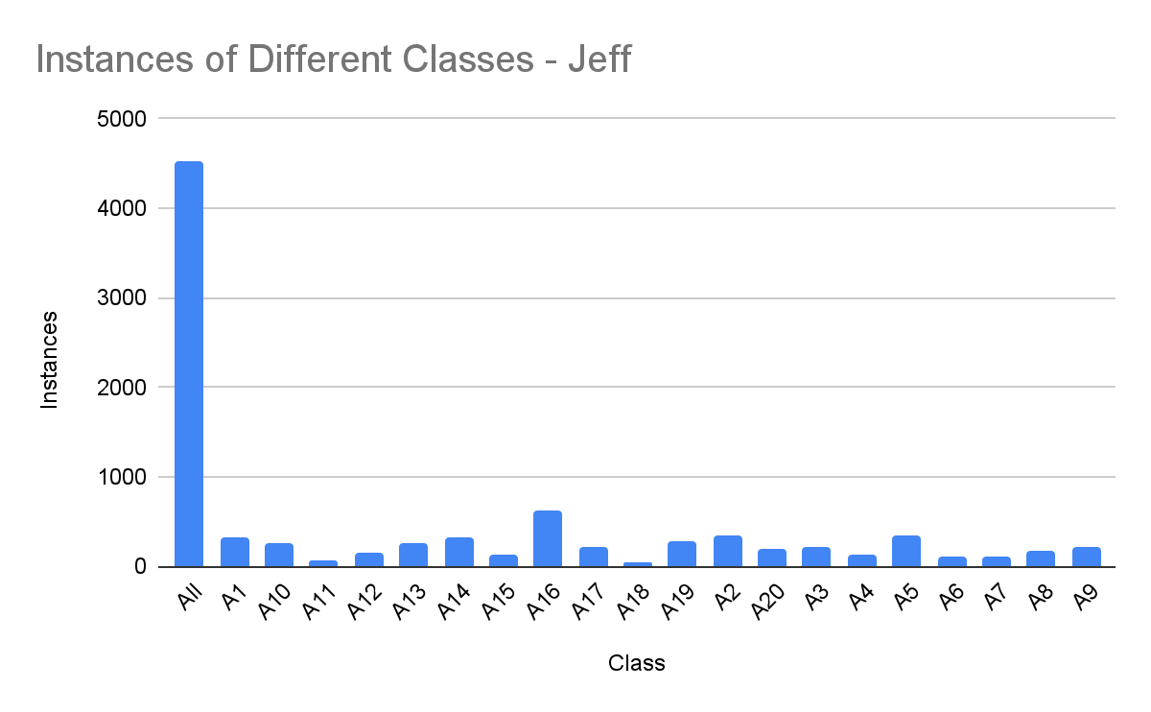
Training Comparisons
Time for Training: 8.968 hours
Time for Training: 21.296 hours

Slide 14
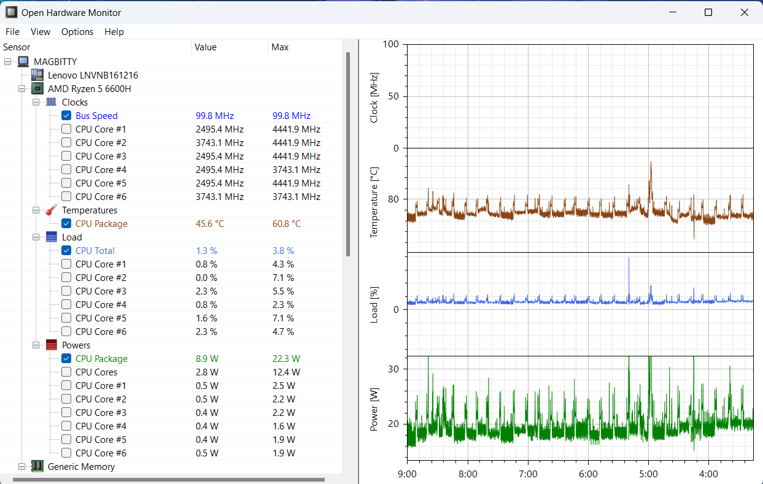
Open Hardware Monitor

Slide 15
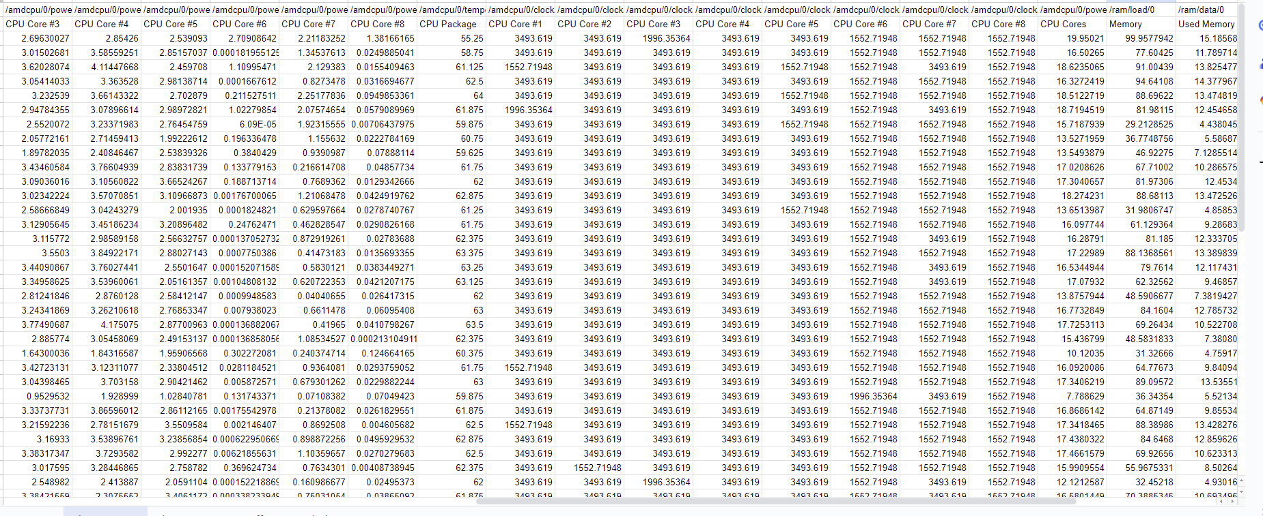
Open Hardware Monitor
How the Data Looks:

Slide 16
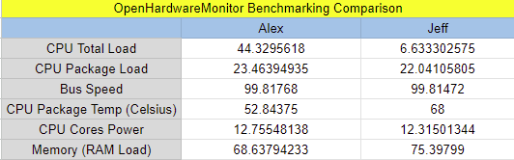
Open Hardware Monitor
Using Averages*

Slide 17
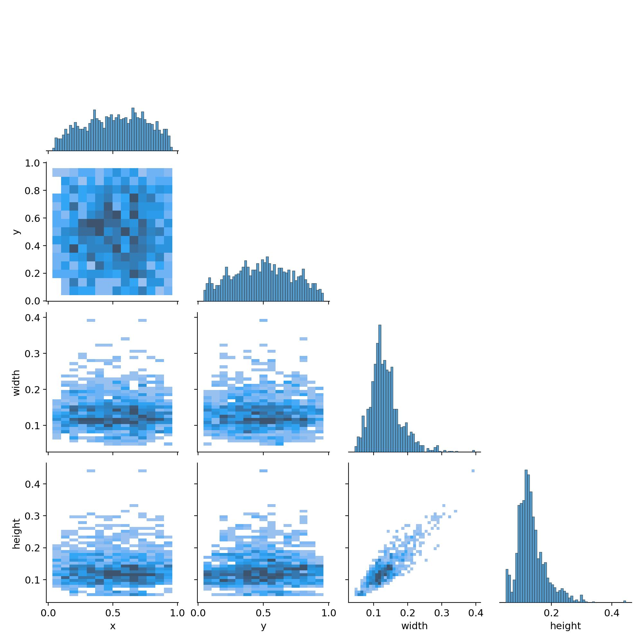
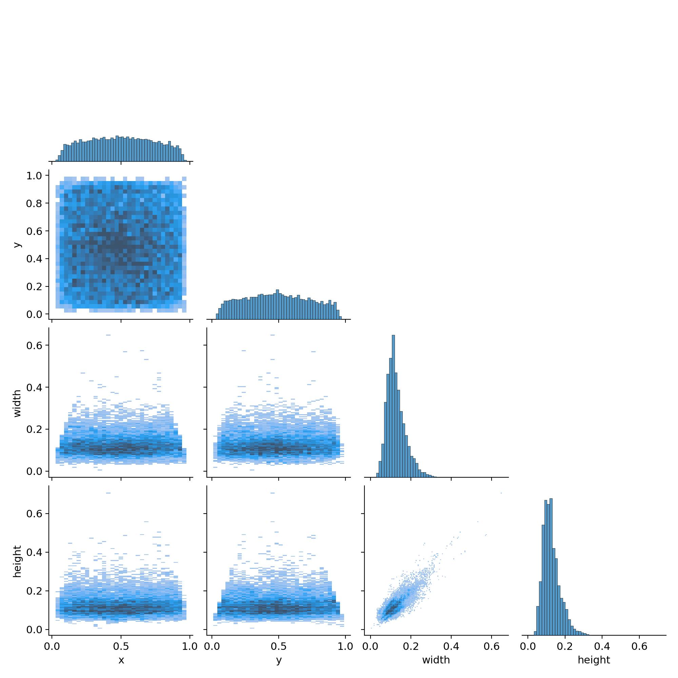
Training (Correlograms)
Alex
Jeff

Slide 18
Training (Correlograms)
Ruben

Slide 19
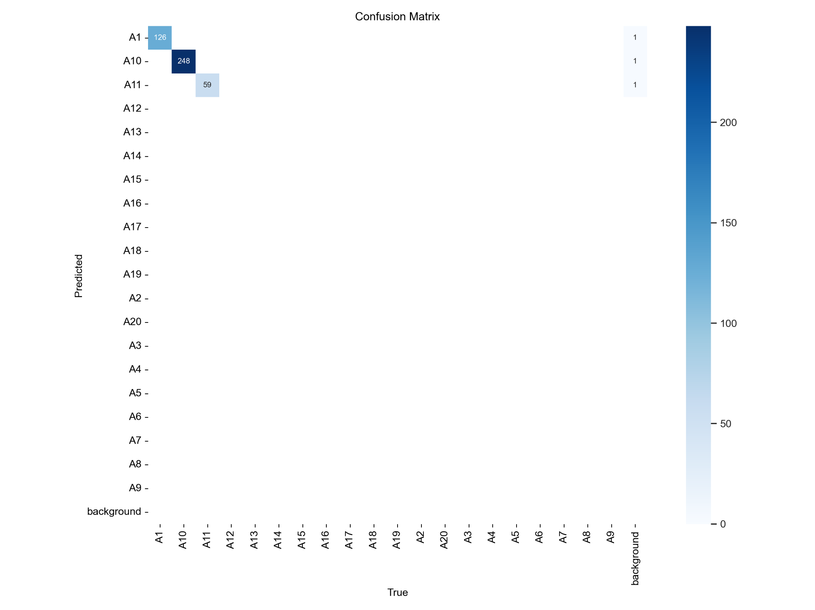
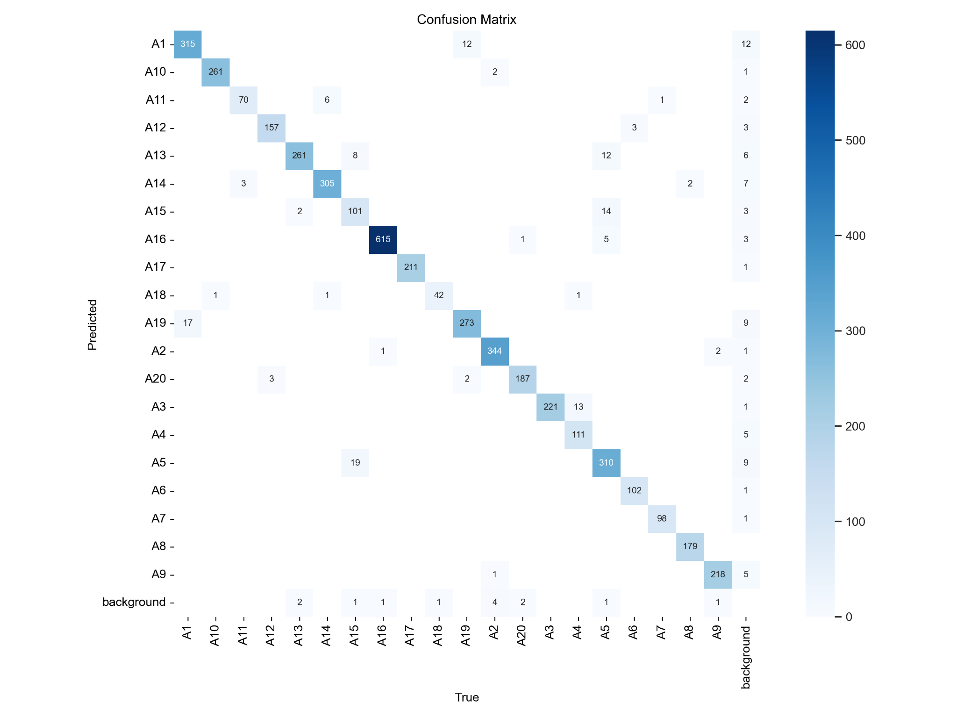
Training (Confusion Matrix)
Alex
Jeff

Slide 20

Training (Confusion Matrix)
Ruben

Slide 21
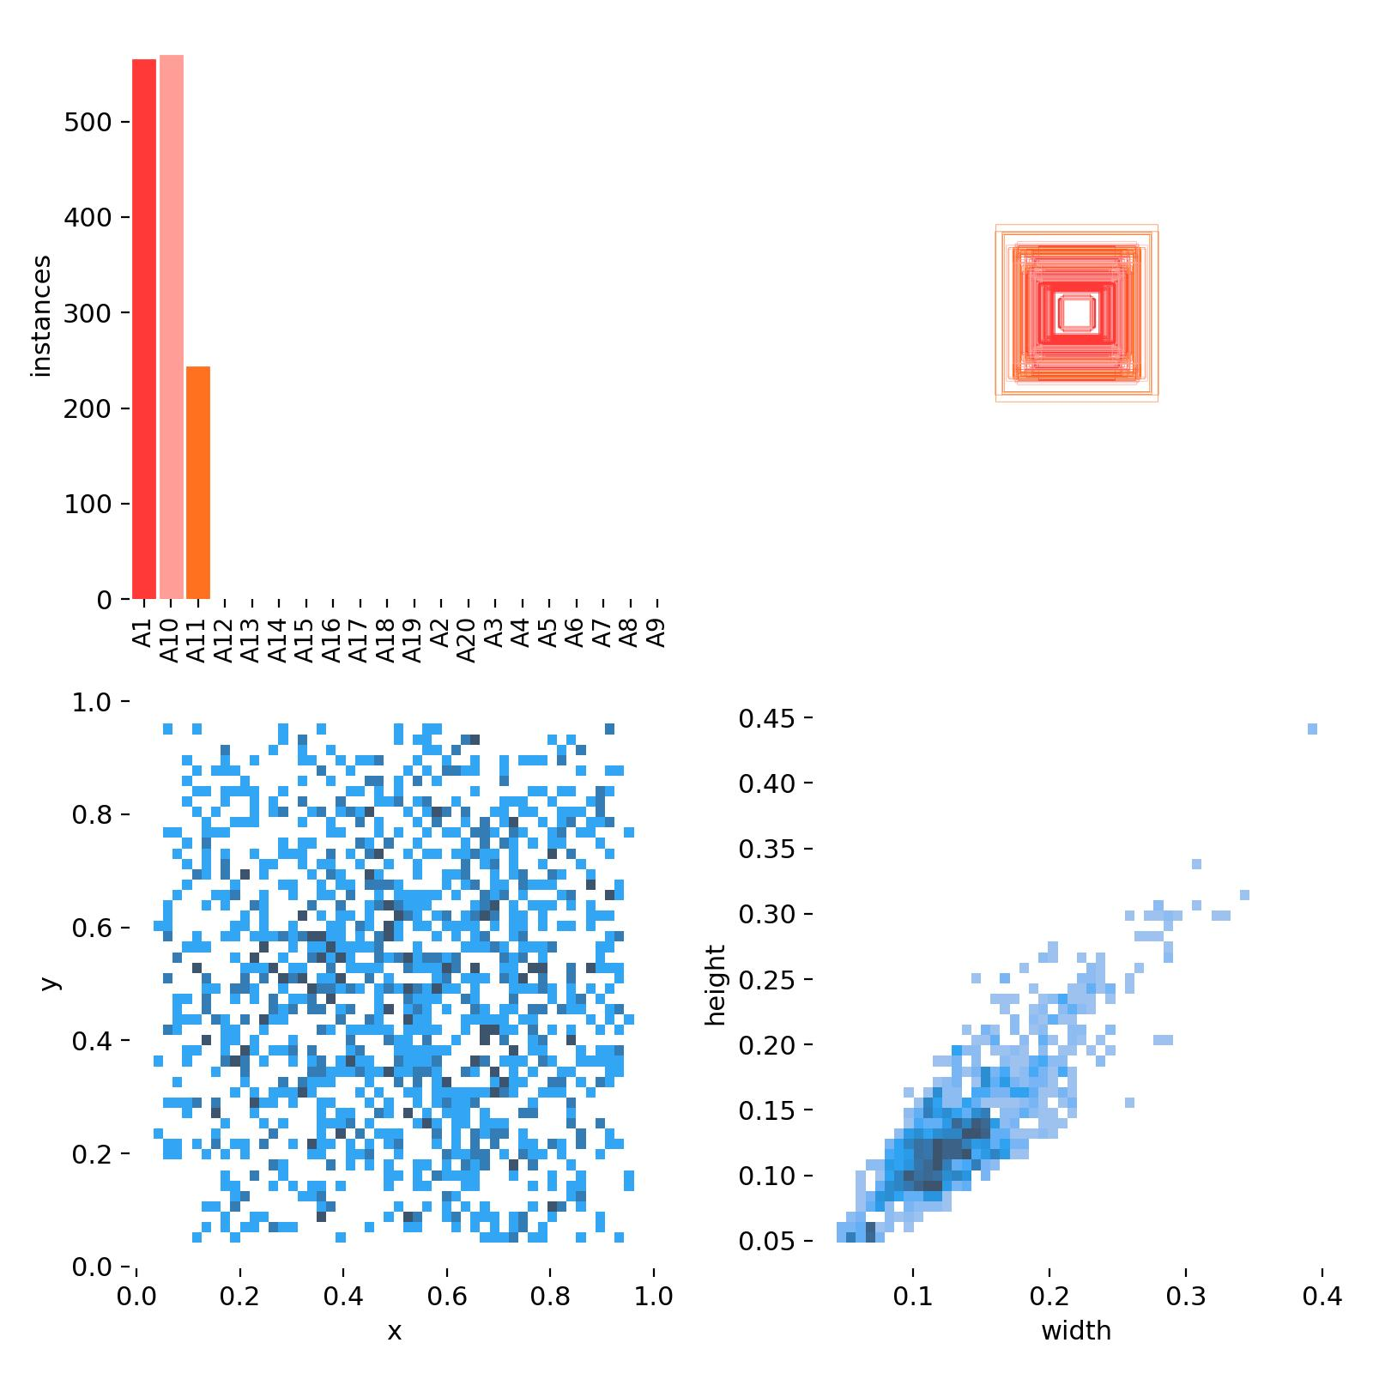
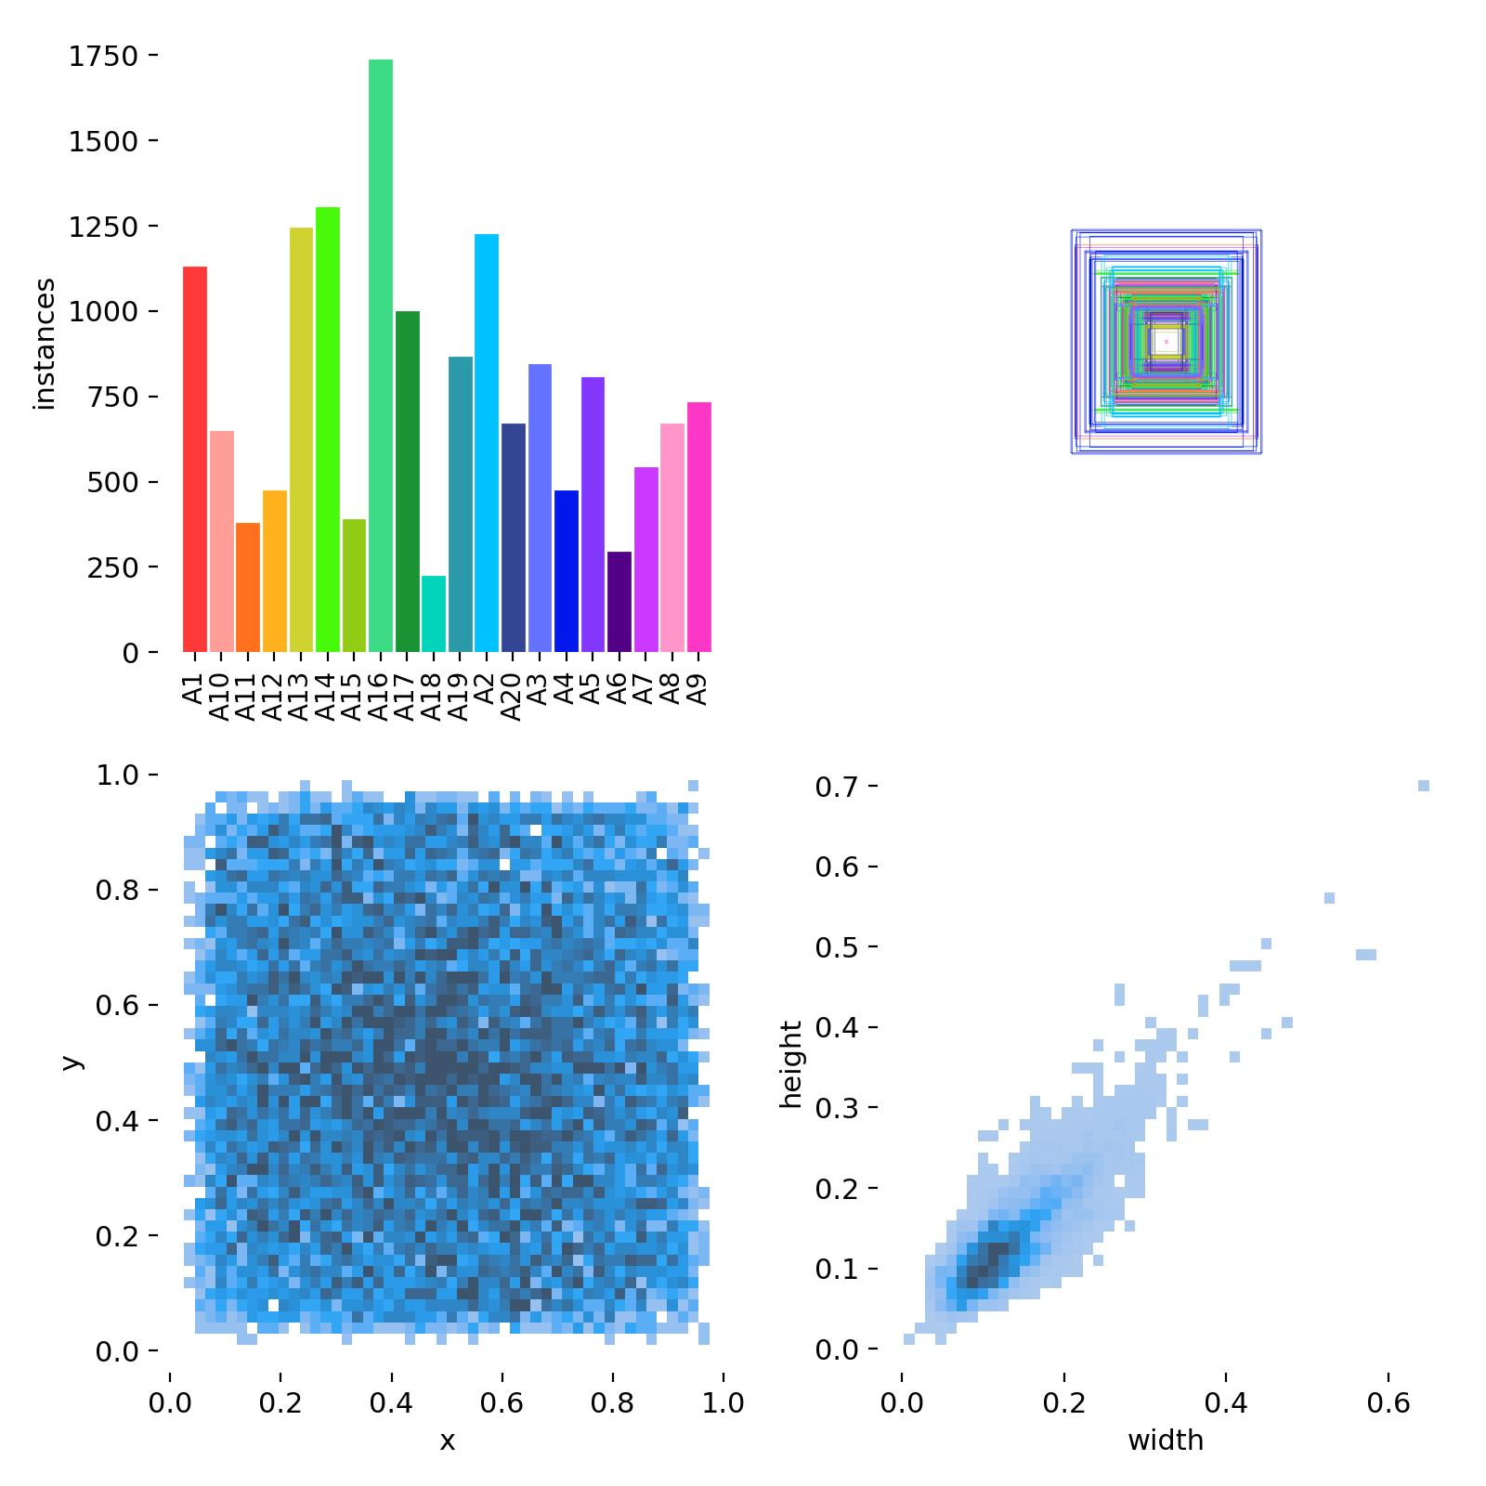
Training (Instances of Different Classes)
Alex
Jeff

Slide 22
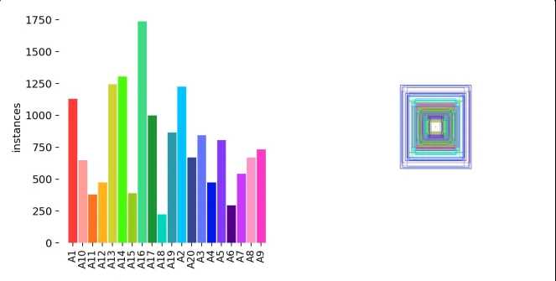
Training (Instances of Different Classes)
Nina
Ruben

Slide 23
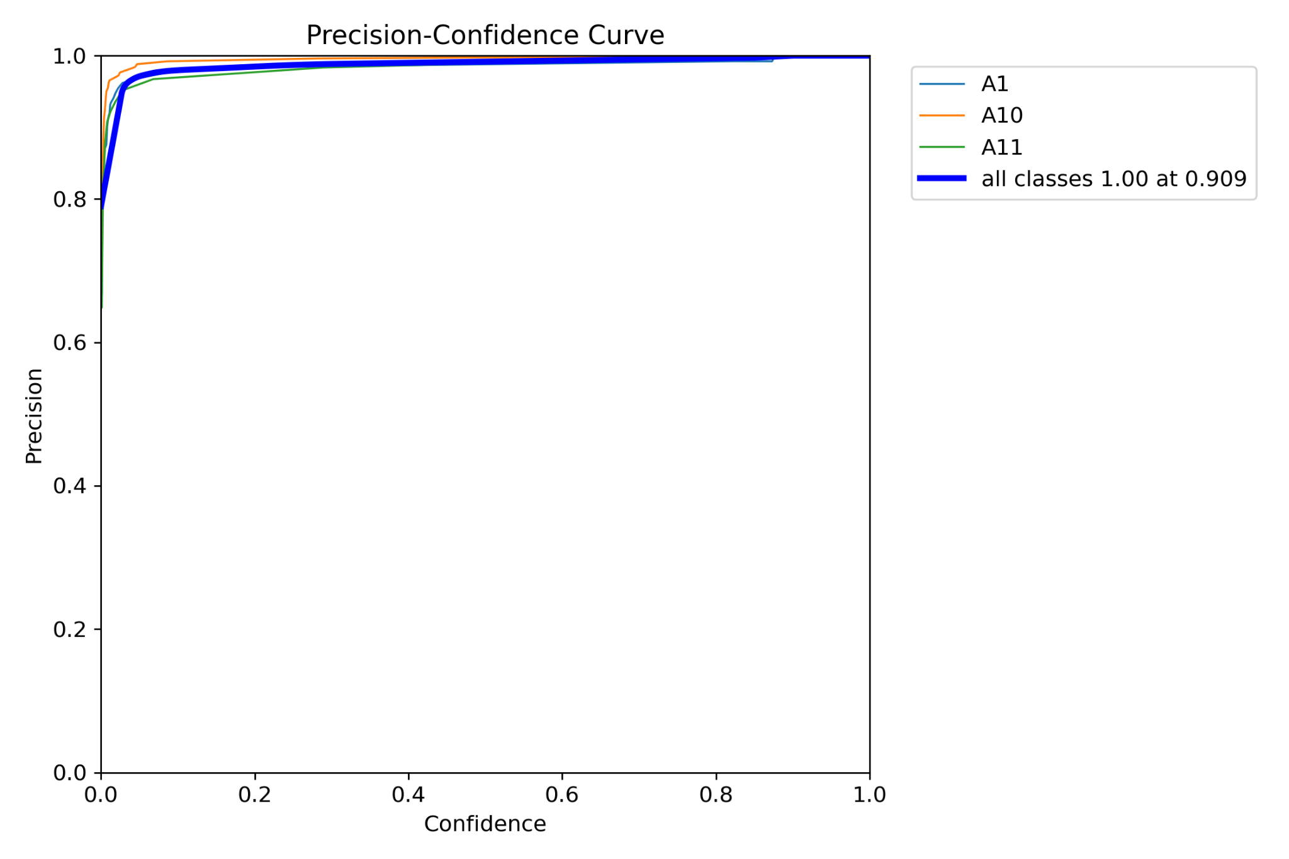
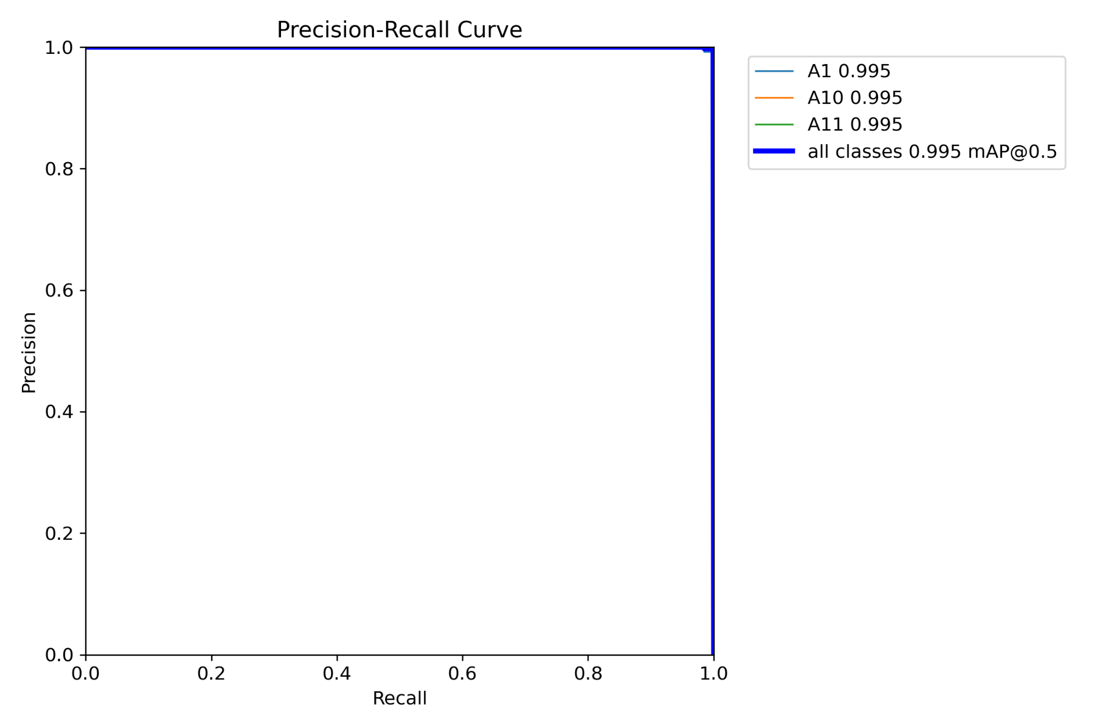
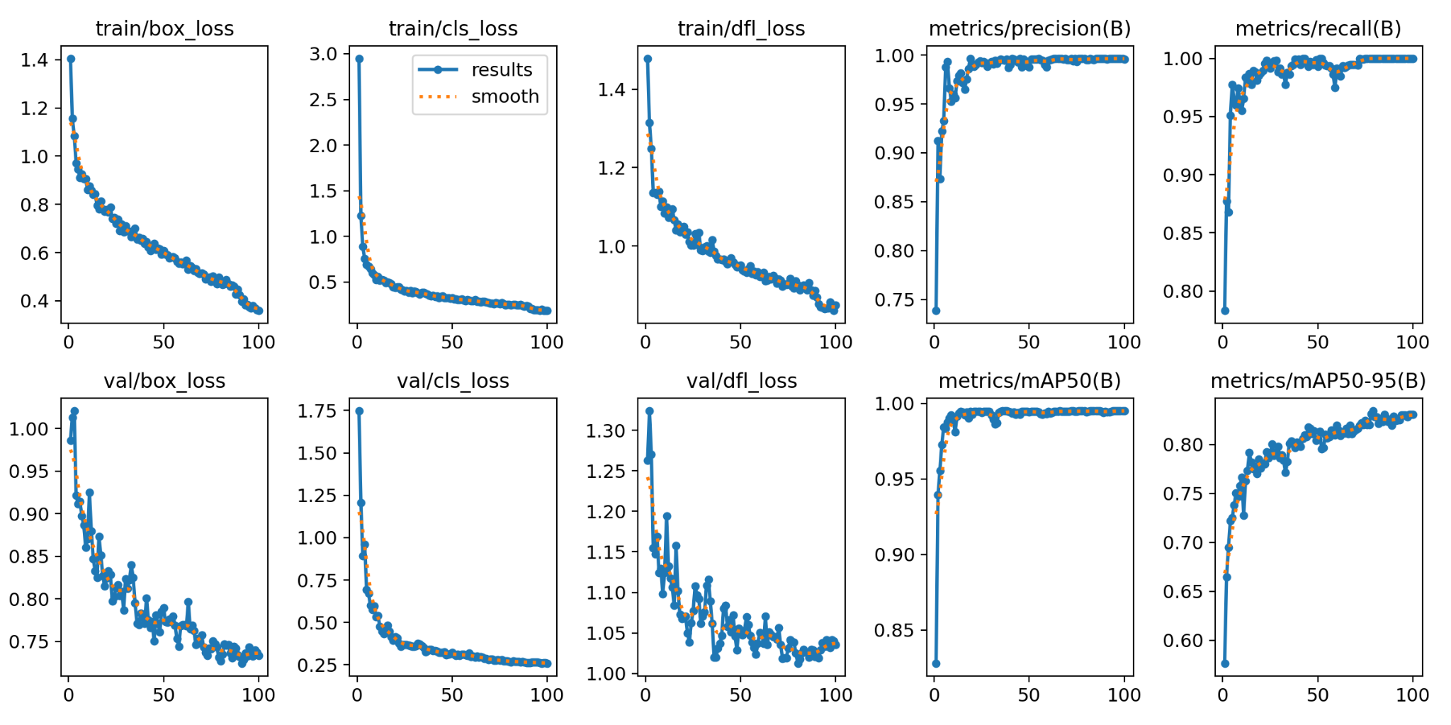
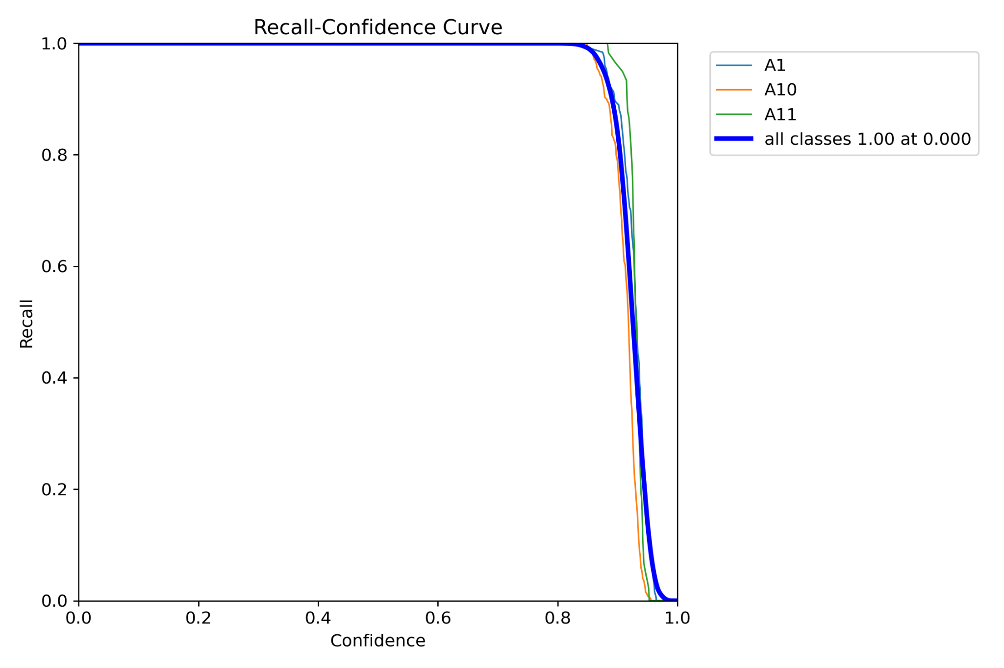
Training
Alex

Slide 24
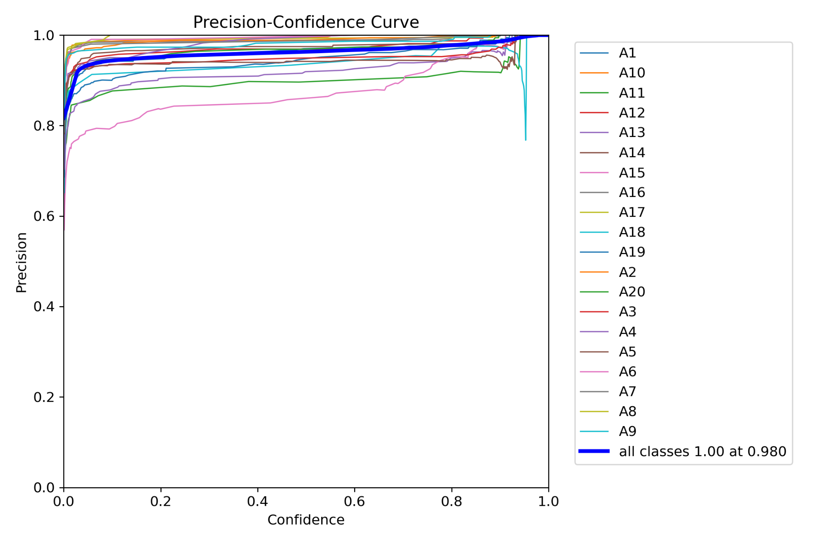
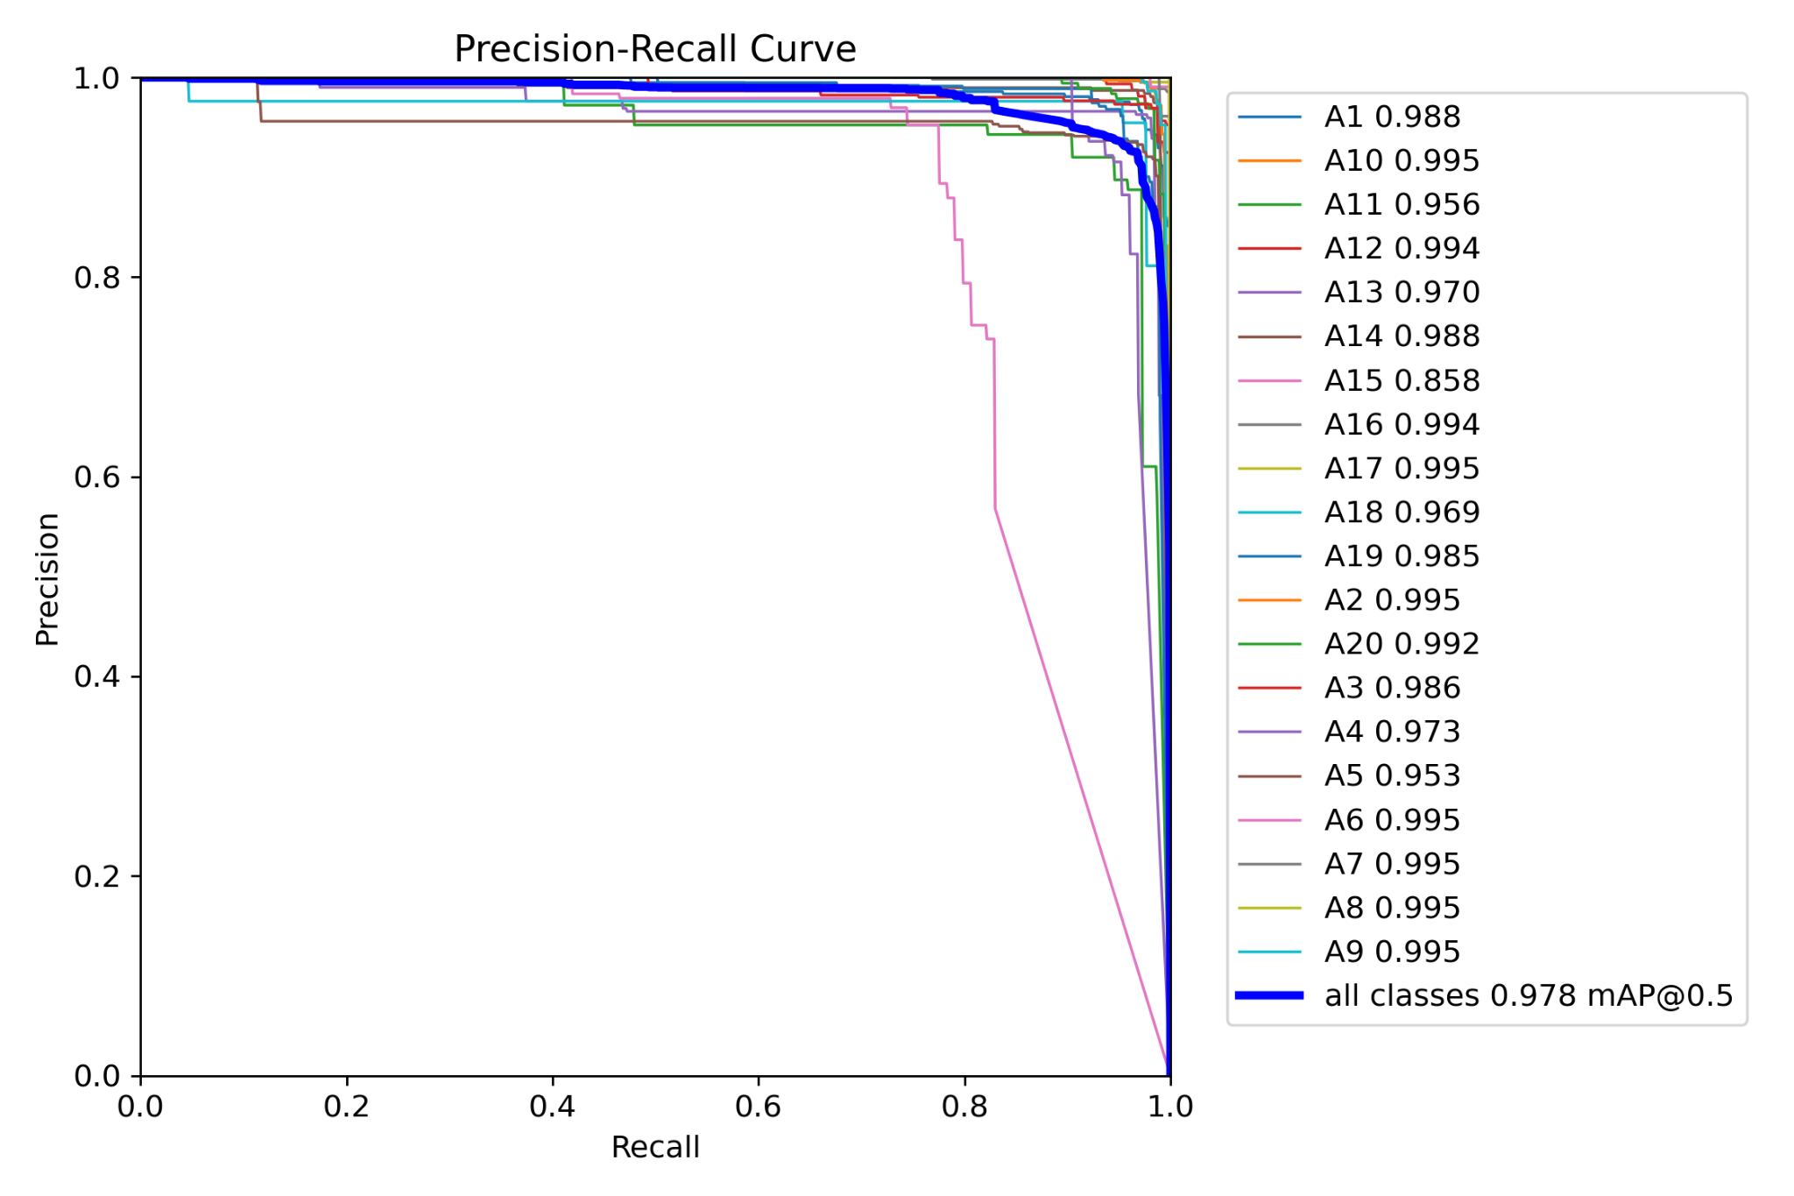
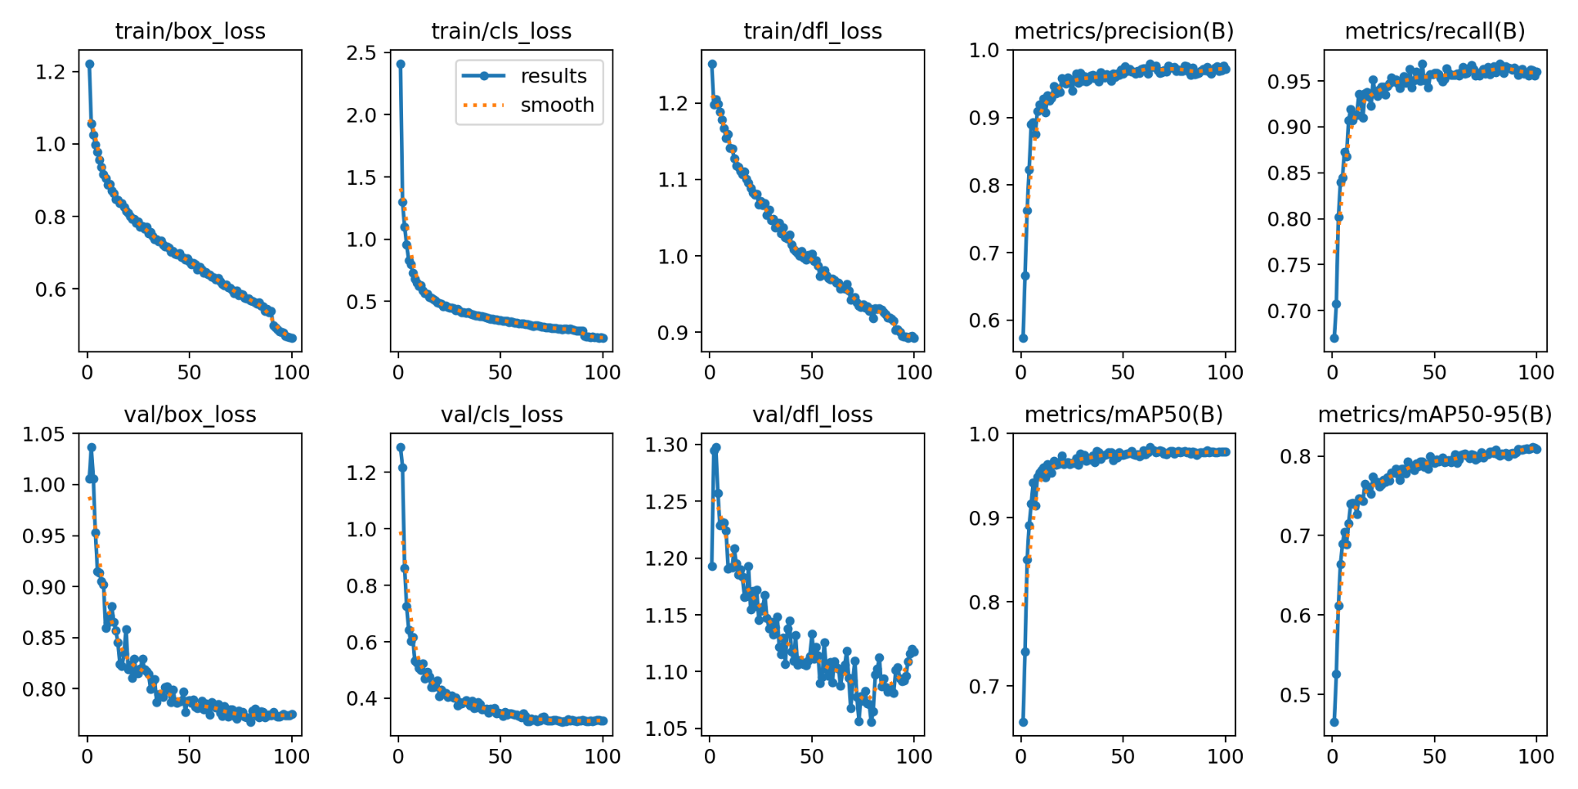
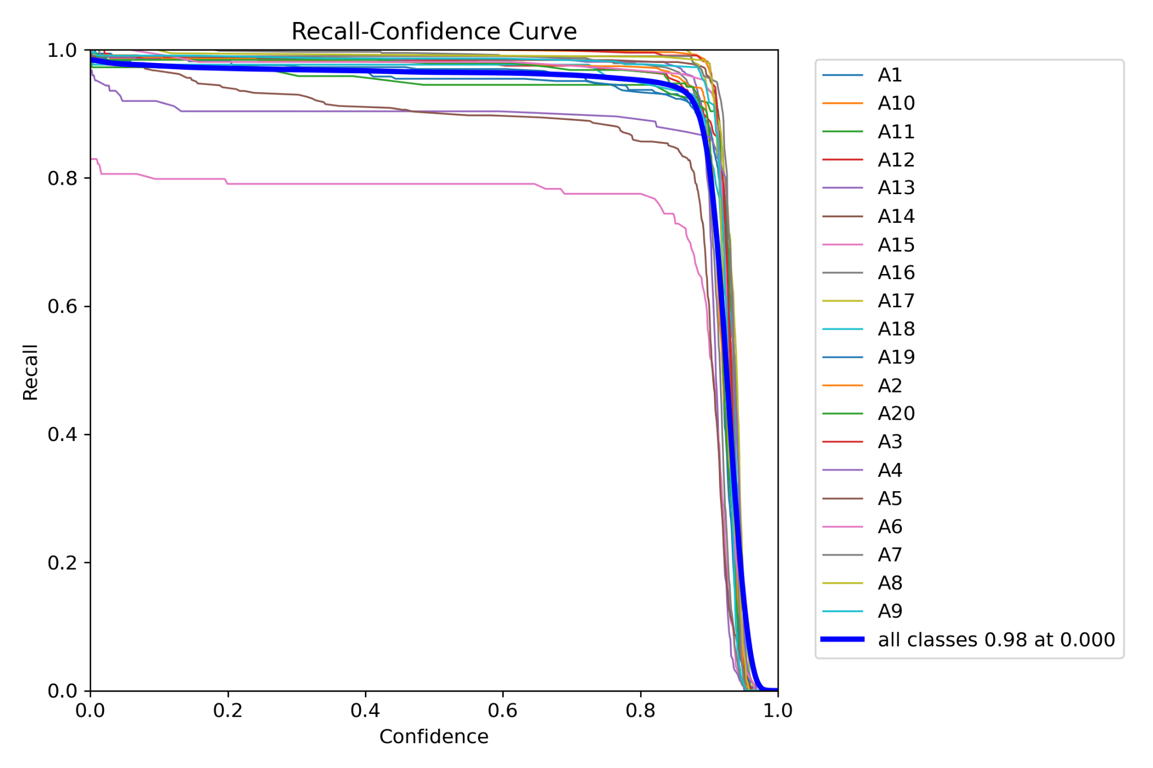
Training
Jeff

Slide 25
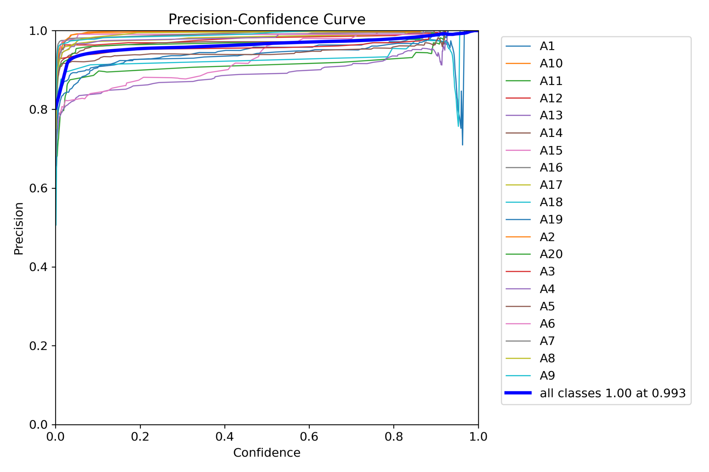
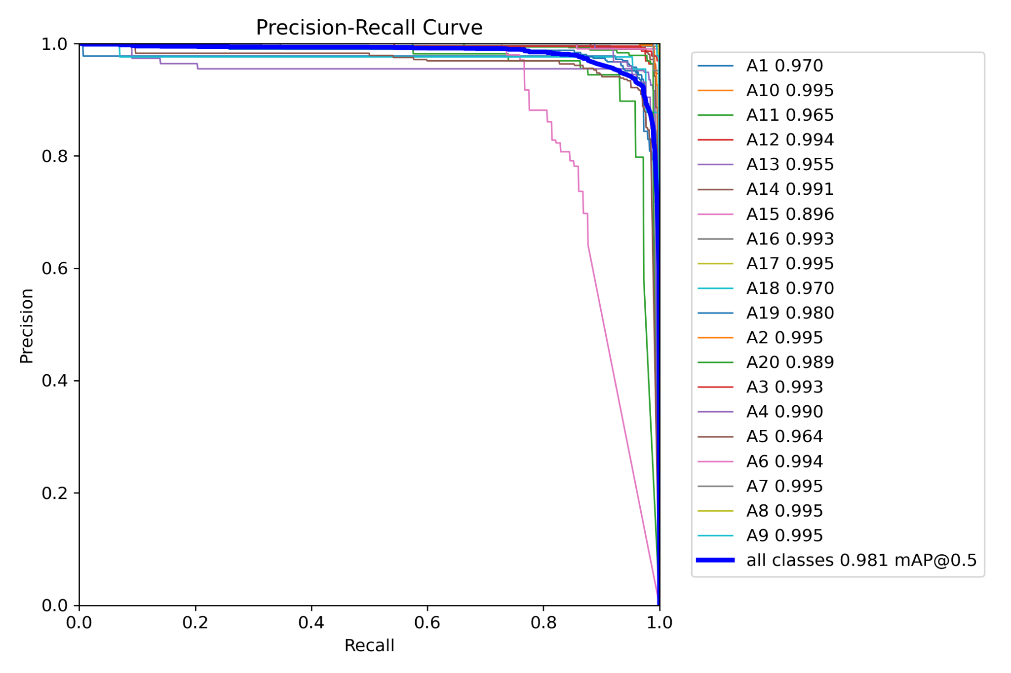
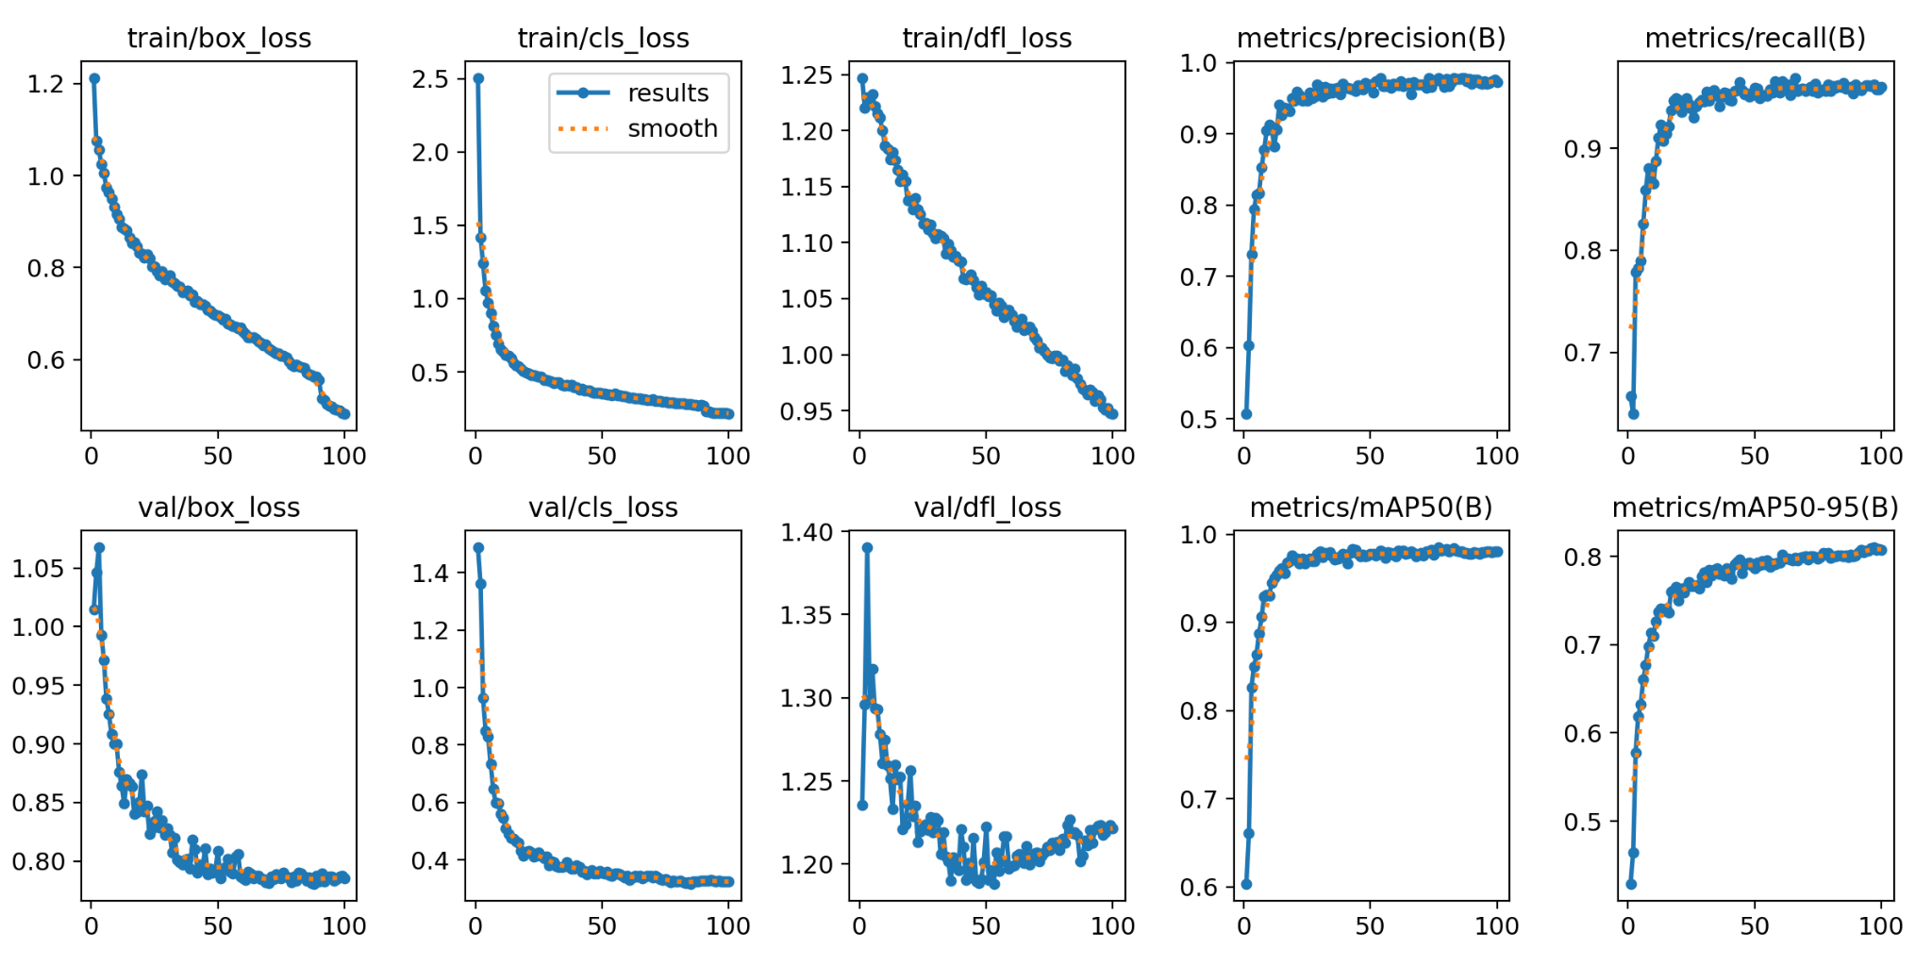
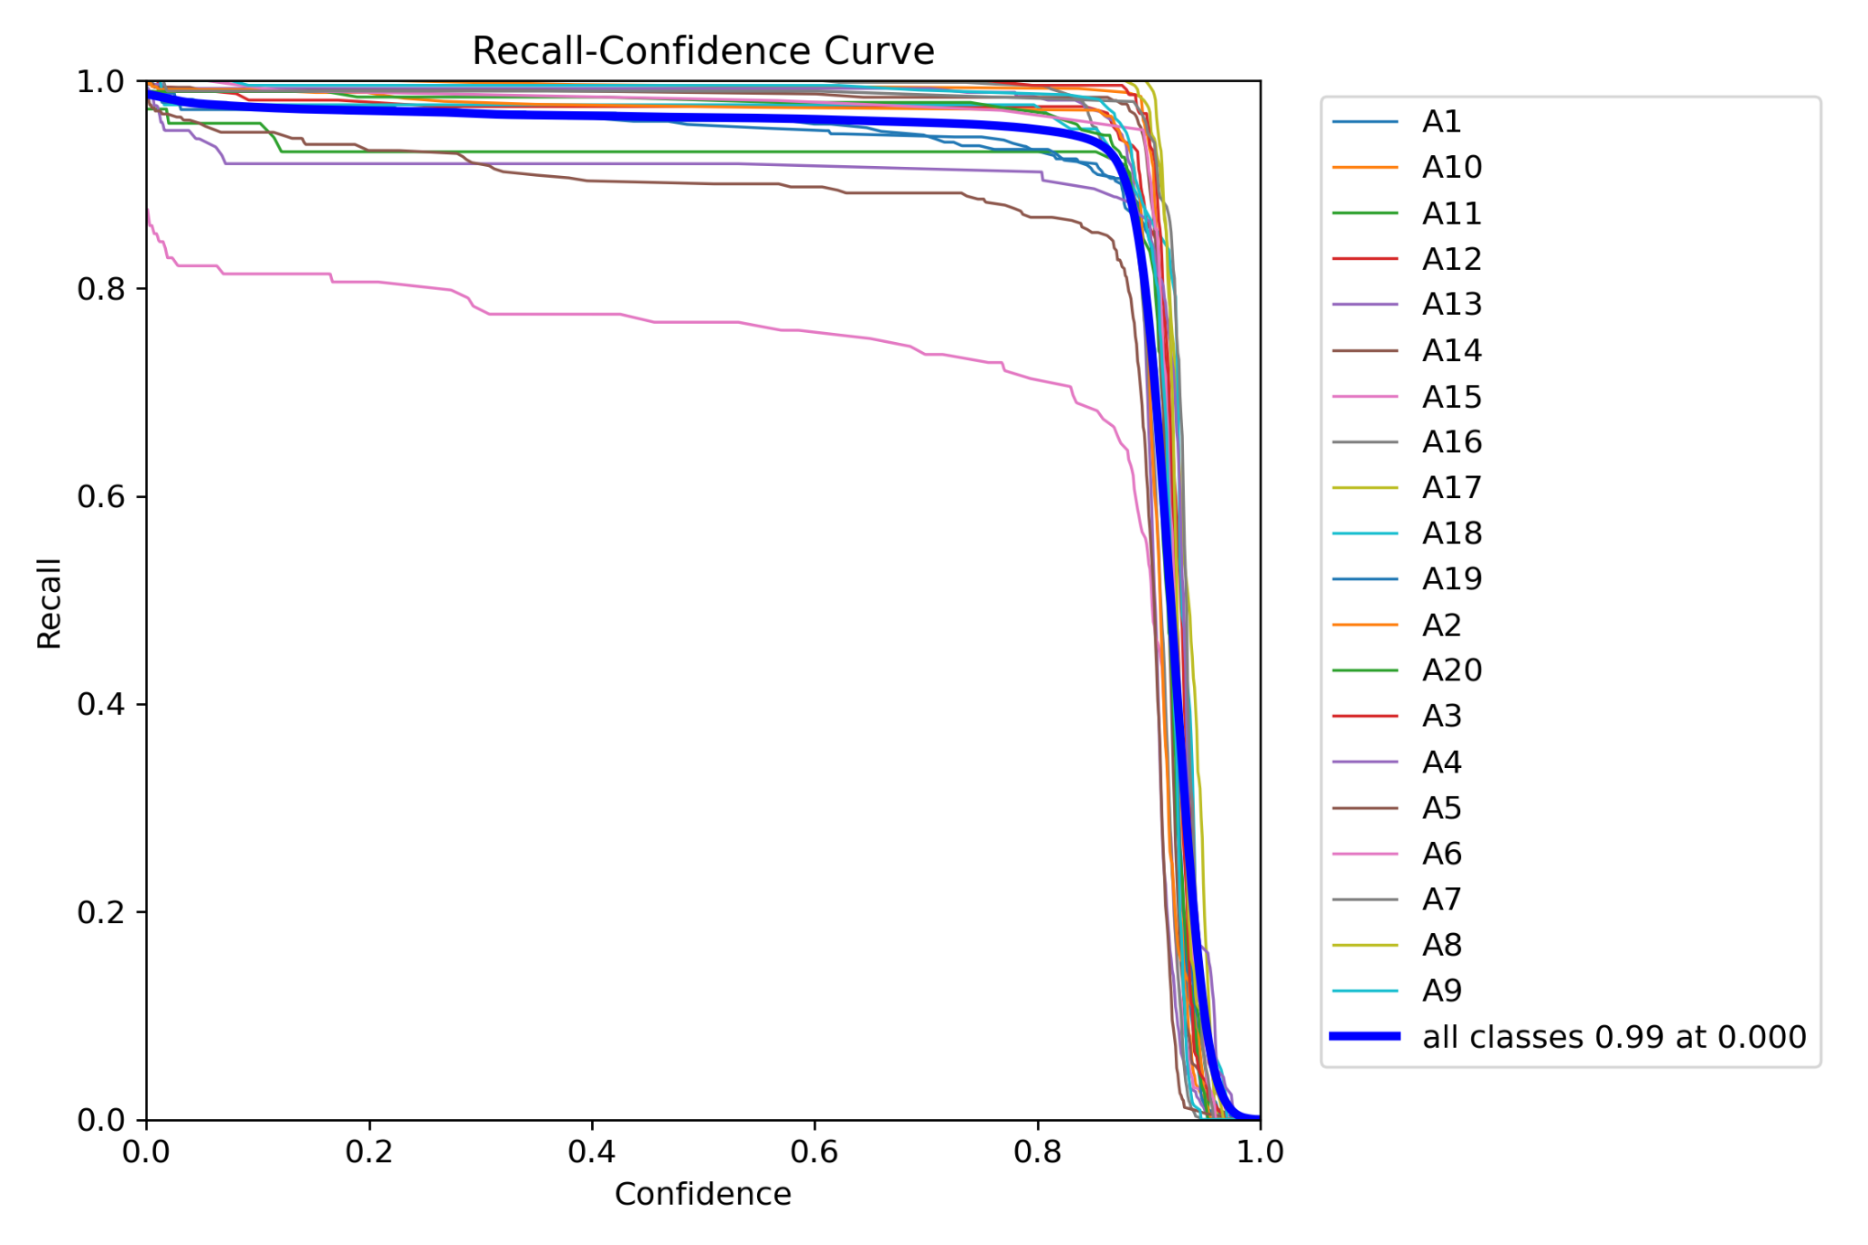
Training
Ruben

Slide 26
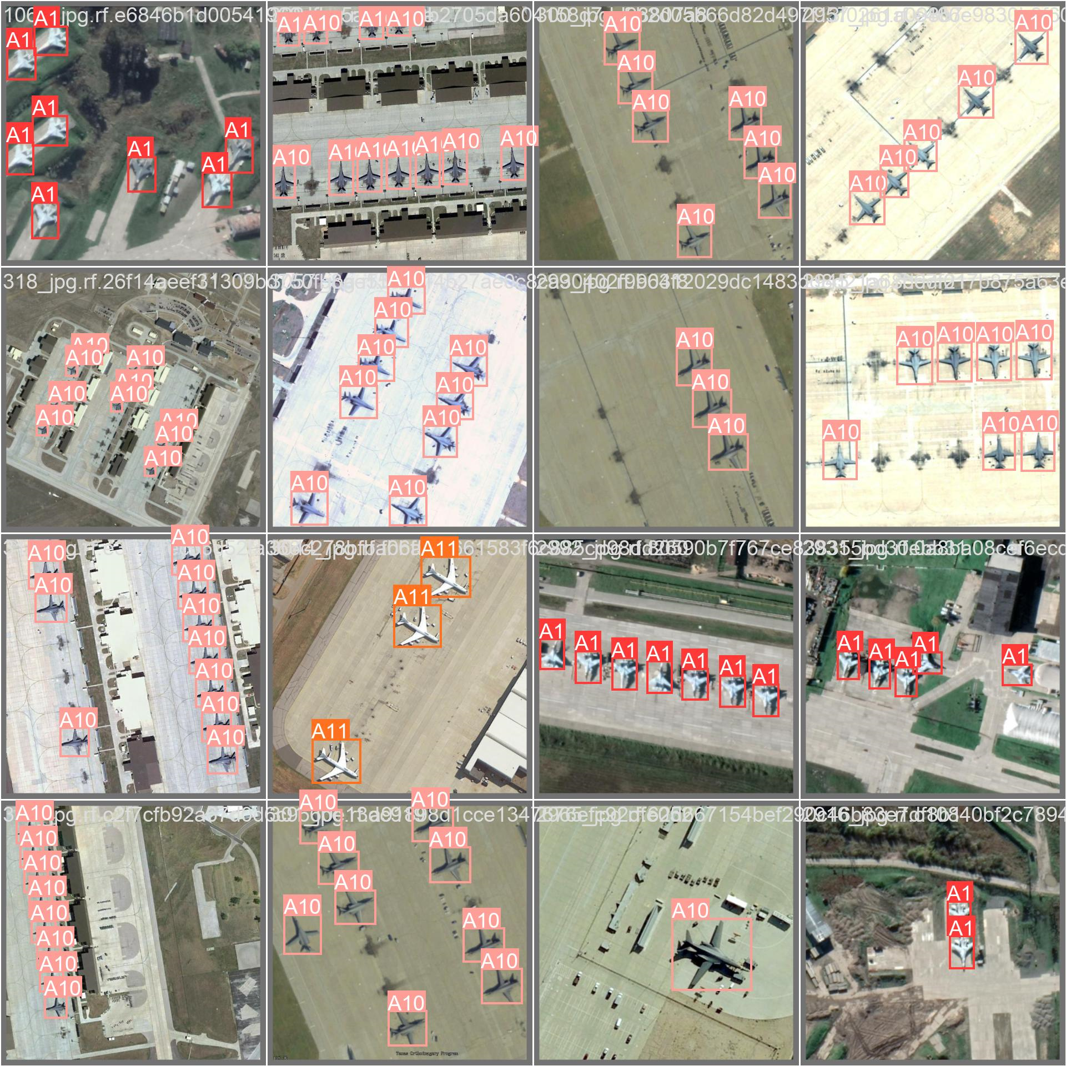
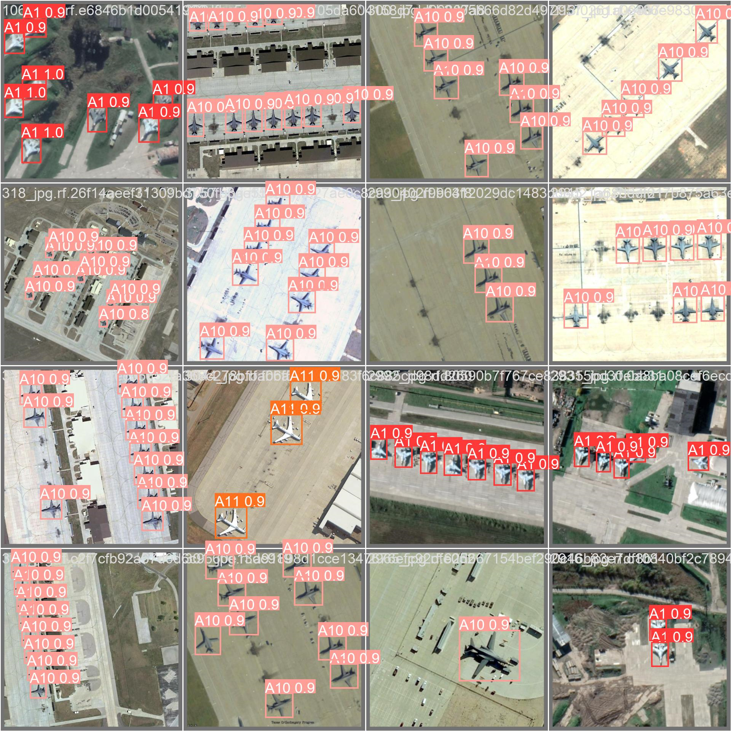
Training

Slide 27
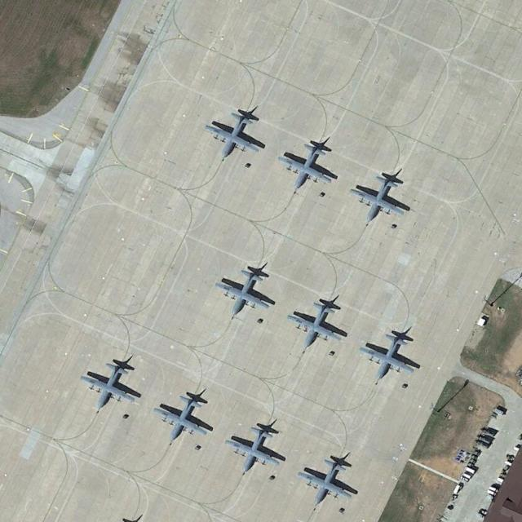
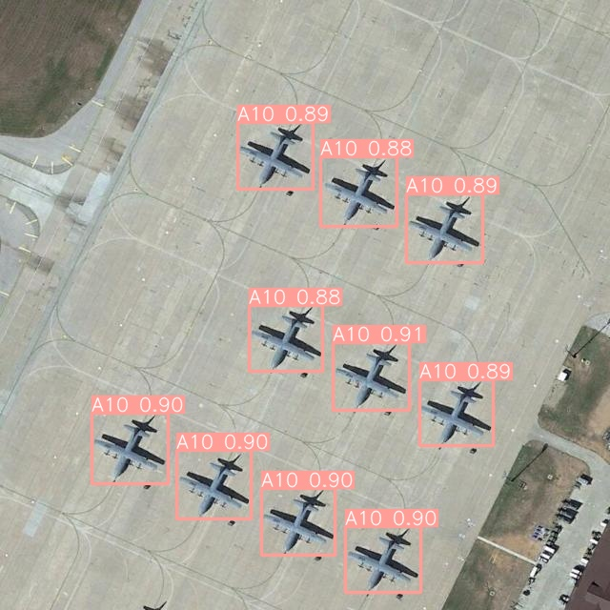
Testing

Slide 28
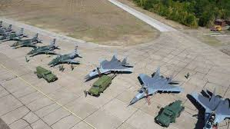
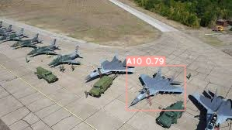
Testing

Slide 29
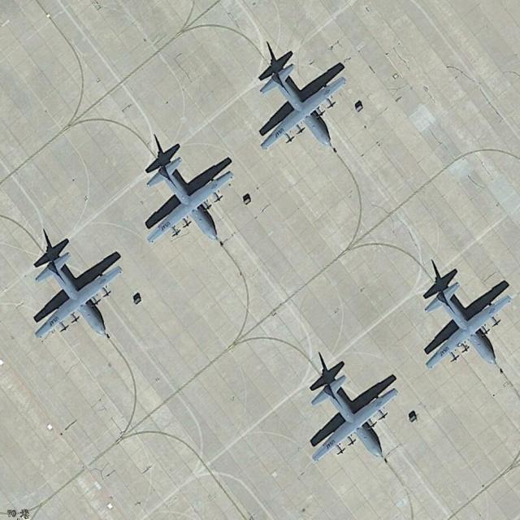
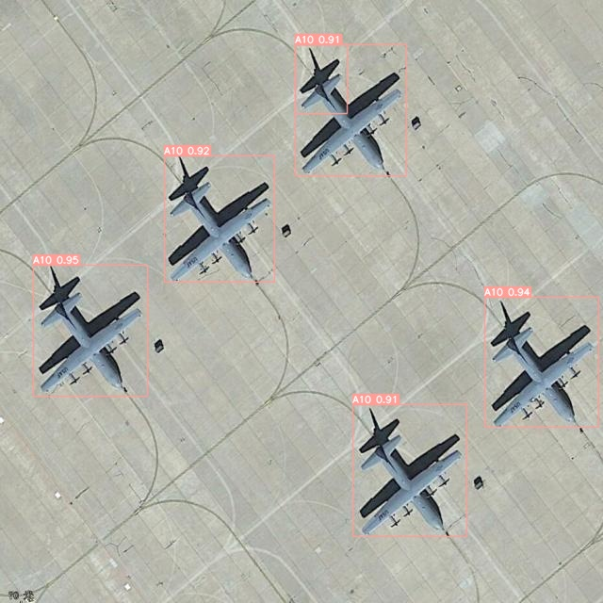
Testing

Slide 30
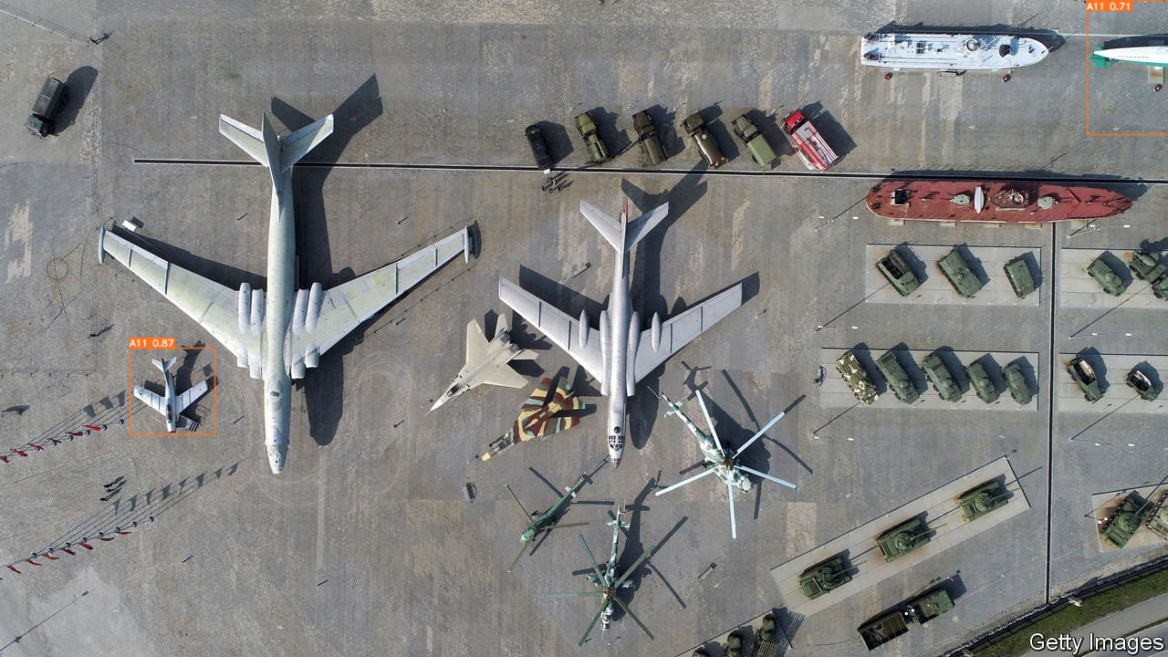

Testing

Slide 31
Conclusion

Slide 32
Conclusion
Alex’s was faster.
Jeff’s was more accurate and descriptive.

Slide 33
Benchmarking YOLOv8 Detecting Airplanes
Alexander Ov, Nina Fajardo, Ruben Banzon, Jeff Magbitang
YOLO
Results
Conclusions
Introduced in 2015 by Joseph Redmon, Santosh Divvala, Ross Girshick, and Ali Farhadi, the YOLO algorithm, which stands for "You Only Look Once," revolutionizes real-time object detection by framing it as a regression problem. The YOLO object detection process involves leveraging four key components: residual blocks, bounding box regression, intersection over unions (IOU), and non-maximum suppression.
For training, the three experimenters who utilized an AMD Ryzen processor ran the YOLO v8 model through 100 epochs, or one complete run through the airplane dataset. The fourth experimenter with the Intel processor had the highest rate of time taken per epoch at about 1.58 hours per epoch. Therefore, the amount of epochs had to decrease in order for the training to complete; this training took 22 epochs as opposed to the 100. Two of the AMD Ryzen processor results are placed below.
After training the YOLOv8 model using the airplane dataset, the model successfully detected pictures of the overhead views of the different plane models. Before using version 8, experimenters tested training using version 7; the training used a significant amount of time to complete, so they used version 8, instead, thus yielding much better results. The AMD Ryzen 9 6900HX processor trained much faster than the AMD Ryzen 5, but the Ryzen 5 provided much more accurate results, as it detected more classes of airplanes.
AMD Ryzen 9 6900HX 8-Core Processor
Objective
AMD Ryzen 5 6600H with Radeon Graphics
This project aims to utilize YOLOv8 to detect a dataset of airplanes while benchmarking the training and testing on different CPUs. Experimenters use Open Hardware Monitor to track the CPU usage for the duration of the experiment.

